Slide 1
Hello, Smart (?)
5G
AI
NDN
IoT
AR
SDN
VR
Jafar Alim Habibi
Sarah Chaerul Annisa

Slide 2
Open
Valid
Trusted
DATA
?
?
?
?
?
?

Slide 3

We know
We don’t store it

Slide 4

Smart
Solution

Slide 5
Start From … ?

Slide 6



Elementary

Slide 7
Vaccine
Data
?

Slide 9


Slide 10
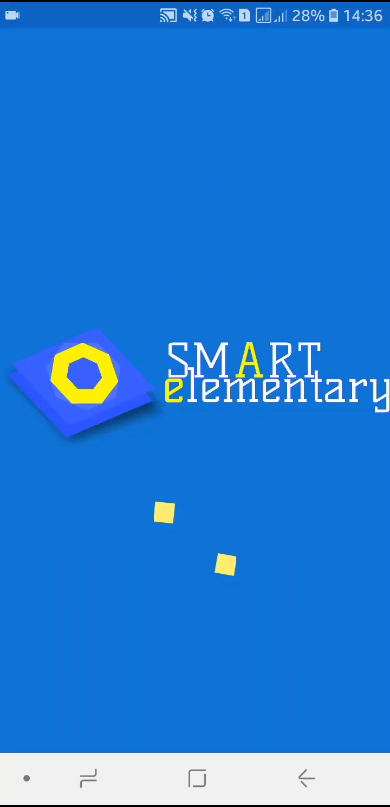
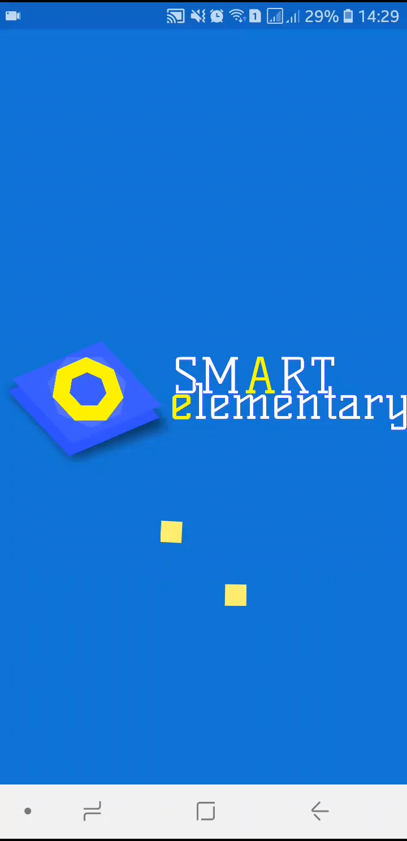

Slide 11
Danke schön

